Slide 1
Capstone data project: Battery Adverse Events Analysis
Iacovos (Jake) Kyprianou, Nathan Smith
US FDA
Center For Devices and Radiological Health

Slide 2
Agenda
What is the problem and who is the end user?
Dataset description
Variables of interest and how are they distributed?
Supervised or unsupervised?
If supervised what is your target variable?
What challenges do you see?
Plan of action - Gantt chart

Slide 3


Slide 4
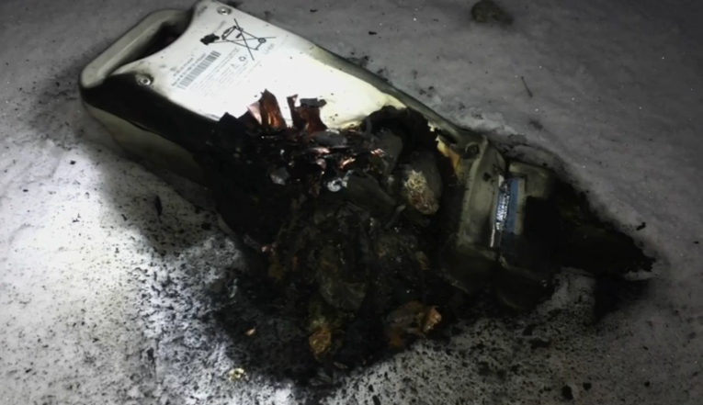
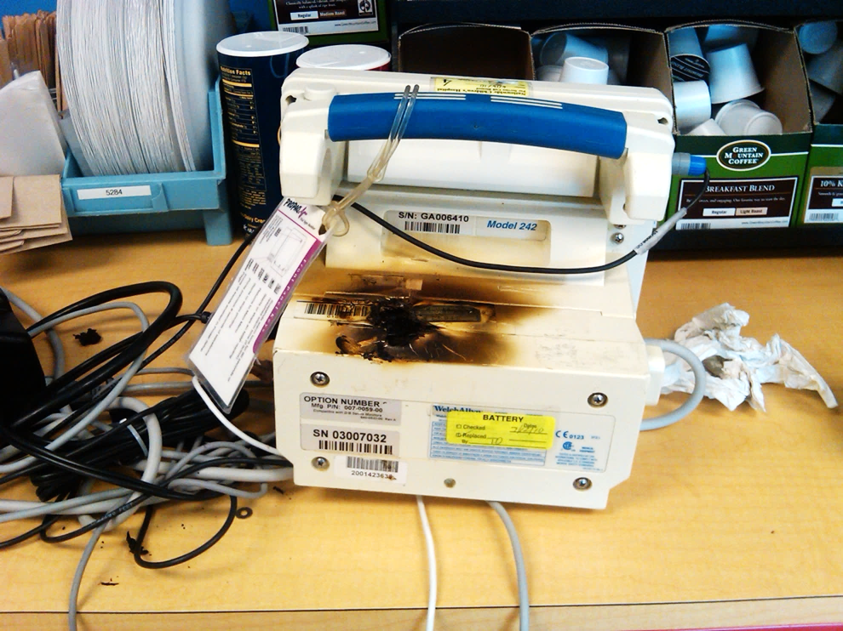
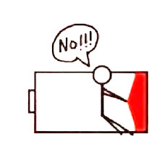
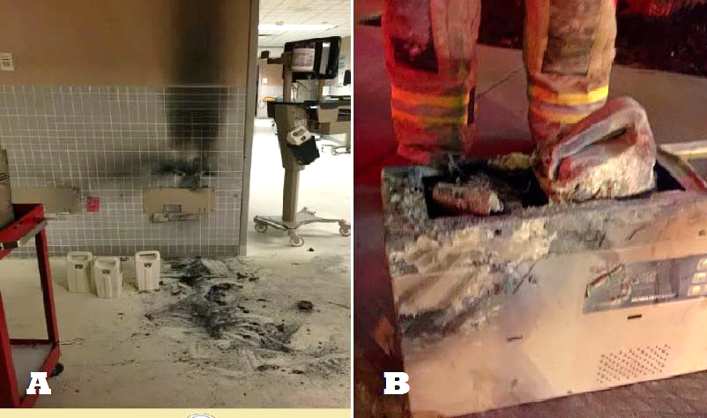
Notes:
Medical battery safety hazards can be divided into two main categories:
Functional hazards, such as premature or unexpected battery depletion which can result in failure to deliver needed and potentially life saving therapies.
Physical Hazards from catastrophic battery failures that can sometimes result in explosions and fires that can lead to hospital evacuations and adversely impact patient care.
Catastrophic battery failures can also, in rare occasions, injure the patient or user.
In today’s session we will primarily focus on the physical hazards of high capacity batteries as it is a low hanging fruit to address. We are hoping to tackle additional topics in future sessions.

Slide 5
Problem statement
Currently regulatory approach to reducing battery related adverse events is not data driven.
The battery related premarket questions and evidence the FDA asks for are generic and not risk-based
The postmarket surveillance and compliance strategy is generic and not risk-based
End user:
Premarket submission review staff and consultants
Post market surveillance and compliance staff

Slide 6
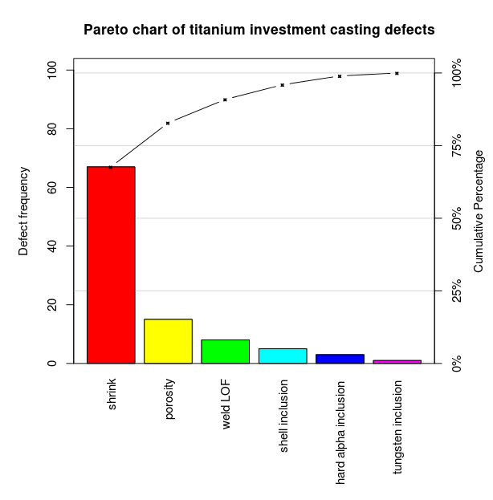
Proposed solution
Discriminate between battery and non battery related events
Develop Pareto Charts for battery adverse event types using text modeling techniques
Strategy:
Supervised: Discriminate between battery and non battery
Non-supervised: model topics using Latent Dirichlet Allocation
80% of the effects come from 20% of the causes.

Slide 7

Dataset description
Sample:
EVENT DESCRIPTION: BOSTON SCIENTIFIC CRM RECEIVED INFORMATION THAT THIS IMPLANTABLE CARDIOVERTER DEFIBRILLATOR (ICD) ISSUED TWO RED ALERTS IN LATITUDE. THE DEVICE HAD DECLARED END OF LIFE (EOL) BATTERY STATUS, AND EXHIBITED A CHARGE TIMEOUT FAULT DUE TO A CHARGE TIME OF 45.1 SECONDS. THE MONITORING VOLTAGE WAS 3.12V. A SAVE TO DISK WAS SENT IN FOR ENGINEERING EVALUATION, BUT IMMEDIATE DEVICE REPLACEMENT WAS RECOMMENDED. THE DEVICE WAS EXPLANTED THE FOLLOWING DAY AND REPLACED WITH ANOTHER BOSTON SCIENTIFIC ICD. THERE WERE NO ADVERSE PATIENT EVENTS WERE REPORTED.

Slide 8
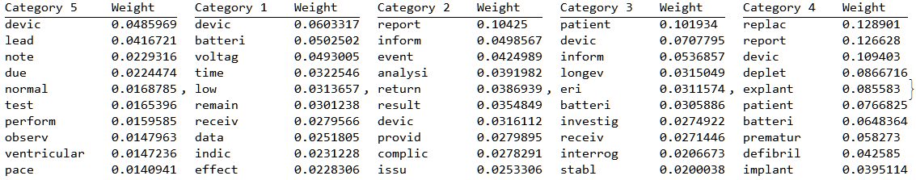
Challenges
No available data for developing a supervised classifier
Discriminate between battery and non-battery events
Unsupervised topic modeling will require a lot of interpretation
Other
Cleaning data
Deciding on n-grams
?

Slide 9
